Slide 1
A107 Physics
P13: The Material Matters!

Slide 2
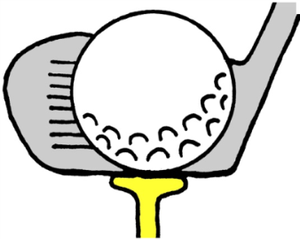
A group of students was tasked by their lecturer to make a presentation on deformation of materials caused by forcing actions.
The students decided to start by examining how different objects deform when pressed, pulled or hit. One of them mentioned that even golf balls deform, and showed a video he had downloaded recently. They were amazed by the way the golf ball went out of shape when hit by a golf club (Video 1) before regaining its original shape after all that deformation.

Slide 3
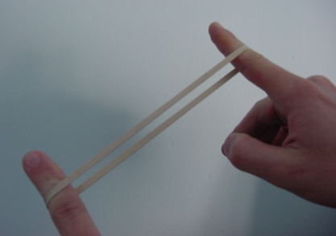
Another student pointed out that not all things return back to the original shape after being deformed. He mentioned plasticine as a highly deformable material that will not return to original shape. He argued that dents on cars are effects of such permanent deformations.
They turned their attention to deformation in rubber bands. Then one of them interrupted asking whether cracking of glass is another form of deformation.

Slide 4
Your challenge for the day!
Limiting your attention to lengthwise pulling of wire-like and rod-like objects, examine typical deformation characteristics (returning to original shape, permanent extension and breaking) of materials.

